Slide 1
The Z-Transformation
(Chapter-8)

Slide 2
Objective
To discuss a transformation (Z-transform) which converts a discrete-time signal, which is a sequence of real or complex numbers, into a complex frequency domain
Methodologies:
Using the properties and definition of Z-transform we will develop some formulae

Slide 3
Application of z-transform:
Areas of this transform wherever it is used are:
Digital signal processing
Population science
Control theory
Z transform is used in many applications of mathematics and signal processing. The lists of applications of z transform are:-
Used to analyze digital filters
Used to analyze digital data (JPEG images, MP3 and MP4 songs, ZIP files etc.)
Used to simulate the continuous systems
Analyze the linear discrete system
Used to finding frequency response
Analysis of discrete signal
Helps in system design and analysis and also checks the systems stability
For automatic controls in telecommunication
Enhance the electrical and mechanical energy to provide dynamic nature of the system

Slide 4

The z-transform:
The z-transform of a sequence $x[n]$ is defined as
$Z\left\{x\left[n\right]\right\}= \sum_{n=−∞}^{∞}{x\left[n\right]}z^{−n}=X(z)$ (1)
This equation is, in general, an infinite sum or infinite power series, with z being a complex variable
The z-transform operator transform the sequence $x[n]$ into the function of a continuous complex variable $X\left(z\right)$
The correspondence between a sequence and its z-transform is indicated by the notation $x\left[n\right] \underset{↔}{Z} X(z)$
Eq.(1), is often referred to as the two-sided or bilateral z-transform
The one-sided or unilateral z-transform is defined as $X\left(z\right)=\sum_{n=0}^{∞}{x\left[n\right]z^{−n}}$
The bilateral and unilateral transform are equivalent only if $x\left[n\right]=0 for n<0$.
The set of values of z for which the z-transform converges is called the region of convergence (ROC)

Slide 5

Zeros and Poles:
$If X\left(z\right)$ is a rational function inside the ROC, i.e.,
$$X\left(z\right)=\frac{P(z)}{Q(z)}$$
Where $P(z)$ and $Q(z)$ are polynomials in $z$.
The values of $z$ for which $X\left(z\right)=0$ are called the zeros of $X(z)$,
The values of $z$ for which $X\left(z\right)$ is infinite are called the poles of $X(z)$.
The poles of $X(z)$ for finite values of $z$ are the roots of the denominator polynomial.

Slide 6
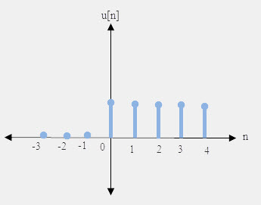
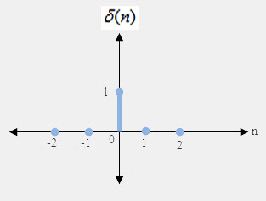
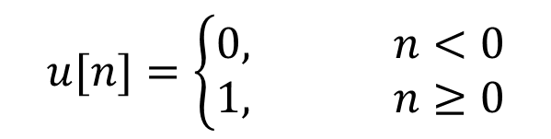
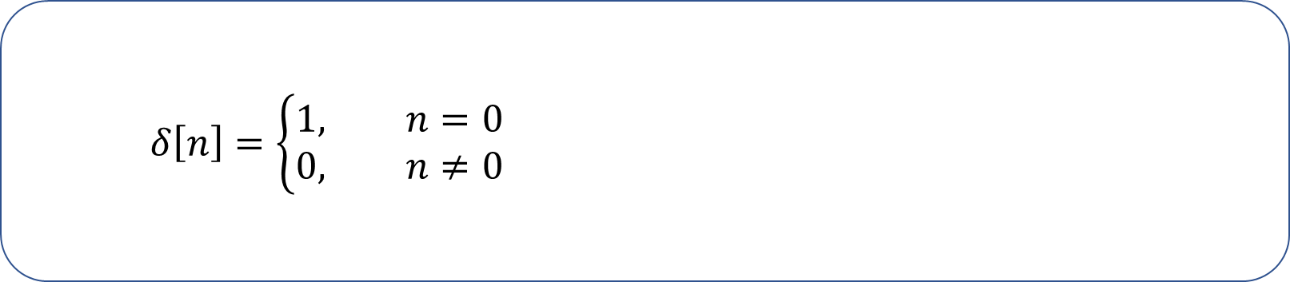
Discrete-Time Unit Step function:
$$u[n]=\left\{\begin{aligned}0, n<0 \\ 1, n≥0\end{aligned}\right.$$
Kronecker delta function or δ - function:
$$δ\left[n\right]=\left\{\begin{aligned}1, n=0 \\ 0, n≠0\end{aligned}\right.$$

Slide 7

Properties of z-transformation:
Linearity property : $ax_{1}\left[n\right]+{bx}_{2}\left[n\right] \underset{↔}{z}{aX}_{1}\left(z\right)+{bX}_{2}\left(z\right), ROC=R_{x_{1}}∩R_{x_{2}} \text{where} \text{a}\text{, }\text{b} \text{are} \text{arbitrary} \text{real} \text{or} \text{complex} \text{constants}\text{.}$
Left Shift of $x\left[n\right]$ in the Discrete-Time domain:
$Z\left\{x\left[n+1\right]\right\}=z\left[X\left(z\right)−x\left[0\right]\right]$, $Z\left\{x\left[n+2\right]\right\}=z^{2}\left[X\left(z\right)−x\left[0\right]−\frac{x\left[1\right]}{z}\right]$ and so on.
Right Shift of $x\left[n\right]$ in the Discrete-Time domain:
$Z\left\{x\left[n−1\right]\right\}=z^{−1}\left[X\left(z\right)+x\left[−1\right]z\right]$, $Z\left\{x\left[n−2\right]\right\}=z^{−2}\left[X\left(z\right)+x\left[−1\right]z+x\left[−2\right]z^{2}\right]$ and so on.
Multiplication by $a^{n}$ in the Discrete-Time domain:
$$a^{n}x\left[n\right] \underset{↔}{z}X\left(\frac{z}{a}\right), ROC={\left|a\right|R}_{x},$$
Multiplication by $e^{−naT}$ in the Discrete-Time domain:
$$e^{−naT}x\left[n\right] \underset{↔}{z}X\left(e^{aT}z\right), ROC={\left|e^{−aT}\right|R}_{x}$$
Multiplication by $n$ and $n^{2}$ in the Discrete-Time domain:
$$nx\left[n\right]\underset{↔}{z}−z\frac{dX(z)}{dz}, ROC=R_{x}.$$
$$n^{2}x\left[n\right]\underset{↔}{z}z\frac{d}{dz}X(z)+z^{2}\frac{d^{2}}{dz^{2}}X(z), ROC=R_{x}.$$
Convolution in the Discrete-Time domain:
$x_{1}\left[n\right]∗x_{2}\left[n\right]\underset{↔}{z}X_{1}\left(z\right)X_{2}\left(z\right), ROC= R_{x_{1}}∩R_{x_{2}}$.

Slide 8
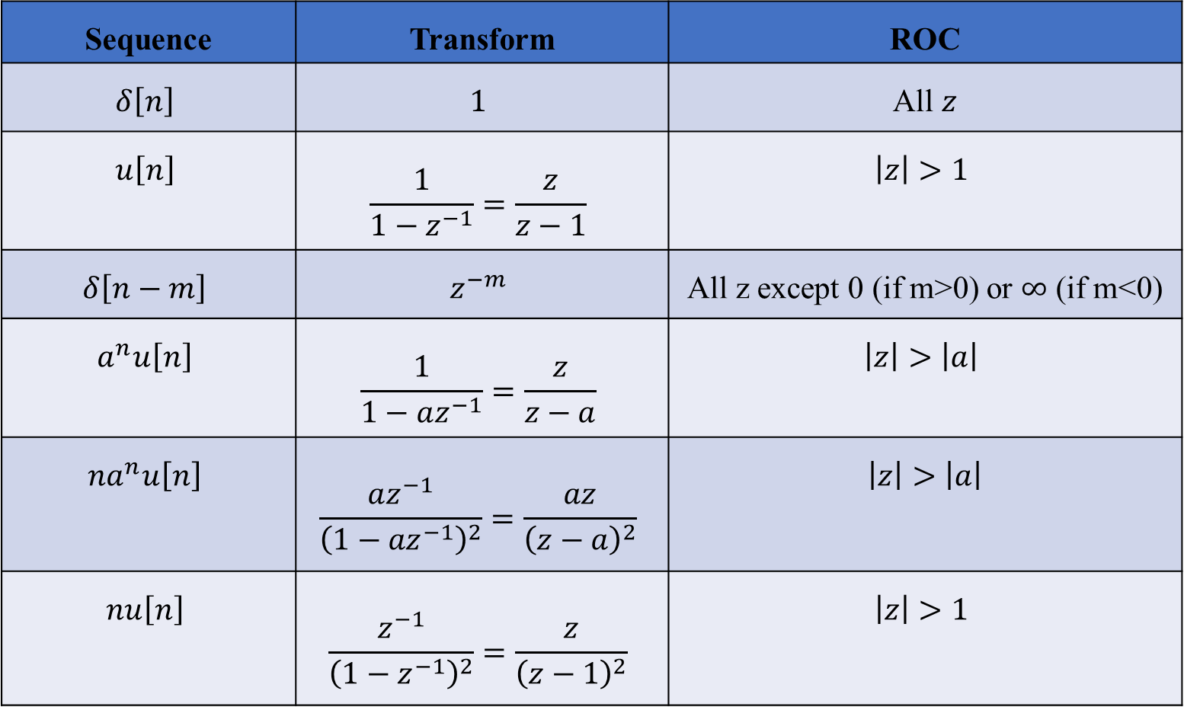
Some common z-transform pairs (One sided):
Sequence | Transform | ROC
$$δ\left[n\right]$$ | $$1$$ | All $z$
$$u\left[n\right]$$ | $$\frac{1}{1−z^{−1}}=\frac{z}{z−1}$$ | $$\left|z\right|>1$$
$$δ\left[n−m\right]$$ | $$z^{−m}$$ | All z except 0 (if m>0) or $∞$ (if m<0)
$$a^{n}u\left[n\right]$$ | $$\frac{1}{1−az^{−1}}=\frac{z}{z−a}$$ | $$\left|z\right|>\left|a\right|$$
$${na}^{n}u\left[n\right]$$ | $$\frac{az^{−1}}{{\left(1−{az}^{−1}\right)}^{2}}=\frac{az}{{\left(z−a\right)}^{2}}$$ | $$\left|z\right|>\left|a\right|$$
$$nu\left[n\right]$$ | $$\frac{z^{−1}}{{\left(1−z^{−1}\right)}^{2}}=\frac{z}{{\left(z−1\right)}^{2}}$$ | $$\left|z\right|>1$$

Slide 9


Prove that $Z\left\{δ\left[n\right]\right\}⟷1$.
Proof: We know that,
$$Z\left\{x\left[n\right]\right\}=\sum_{n=−∞}^{∞}{x\left[n\right]z^{−n}}$$
$$∴Z\left\{δ\left[n\right]\right\}=\sum_{n=−∞}^{∞}{δ\left[n\right]}z^{−n}$$
$$=\sum_{n=−∞}^{−1}{0×z^{−n}+1×z^{−0}+\sum_{n=1}^{∞}{0×z^{−n}}}$$
$$=1 for all z.$$
Hence $Z^{−1}\left\{1\right\}=δ\left[n\right]$.

Slide 10

Prove that $Z\left\{u\left[n\right]\right\}⟷\frac{1}{1−z^{−1}}=\frac{z}{z−1}$.
Proof: We know that
$$Z\left\{x\left[n\right]\right\}=\sum_{n=−∞}^{∞}{x\left[n\right]z^{−n}}$$
$$∴Z\left\{u\left[n\right]\right\}=\sum_{n=−∞}^{∞}{u\left[n\right]z^{−n}}$$
$$=\sum_{n=−∞}^{−1}{0×z^{−n}+\sum_{n=0}^{∞}{1×z^{−n}}}$$
$=1+z^{−1}+z^{−2}+z^{−3}+…$
$=1+\frac{1}{z}+\frac{1}{z^{2}}+\frac{1}{z^{3}}+…$
$={\left(1−\frac{1}{z}\right)}^{−1} for \left|\frac{1}{z}\right|<1$
$=\frac{1}{1−z^{−1}}$ for $1<\left|z\right|$
$=\frac{z}{z−1}$ for $\left|z\right|>1.$
Hence $Z^{−1}\left\{\frac{1}{1−z^{−1}}\right\}=u\left[n\right]$.

Slide 11

Prove that $Z\left\{a^{n}u\left[n\right]\right\}⟷\frac{1}{1−{az}^{−1}}=\frac{z}{z−a}$.
Proof: We know that
$$Z\left\{x\left[n\right]\right\}=\sum_{n=−∞}^{∞}{x\left[n\right]z^{−n}}$$
$$∴Z\left\{a^{n}u\left[n\right]\right\}=\sum_{n=−∞}^{∞}{a^{n}u\left[n\right]z^{−n}}$$
$$=\sum_{n=−∞}^{−1}{0×z^{−n}+\sum_{n=0}^{∞}{a^{n}z^{−n}}}$$
$=1+{az}^{−1}+a^{2}z^{−2}+a^{3}z^{−3}+…$
$=1+\frac{a}{z}+{\left(\frac{a}{z}\right)}^{2}+{\left(\frac{a}{z}\right)}^{3}+…$
$={\left(1−\frac{a}{z}\right)}^{−1} for \left|\frac{a}{z}\right|<1$
$=\frac{1}{1−az^{−1}}$ for $\left|a\right|<\left|z\right|$
$=\frac{z}{z−a}$ for $\left|z\right|>\left|a\right|.$
Hence $Z^{−1}\left\{\frac{1}{1−az^{−1}}\right\}=a^{n}u\left[n\right]$.

Slide 12

Prove that $Z\left\{n u\left[n\right]\right\}⟷\frac{z^{−1}}{{\left(1−z^{−1}\right)}^{2}}=\frac{z}{{\left(z−1\right)}^{2}}$.
Proof: We know that
$$Z\left\{x\left[n\right]\right\}=\sum_{n=−∞}^{∞}{x\left[n\right]z^{−n}}$$
$$∴Z\left\{n u\left[n\right]\right\}=\sum_{n=−∞}^{∞}{n u\left[n\right]z^{−n}}$$
$$=\sum_{n=−∞}^{−1}{0×z^{−n}+\sum_{n=0}^{∞}{n×z^{−n}}}$$
$=0+z^{−1}+{2z}^{−2}+3z^{−3}+4z^{−4}+…$
$$=z^{−1}\left(1+{2z}^{−1}+3z^{−2}+4z^{−3}+…\right)$$
$={z^{−1}\left(1−\frac{1}{z}\right)}^{−2} for \left|\frac{1}{z}\right|<1$
$=\frac{z^{−1}}{{\left(1−z^{−1}\right)}^{2}}$ for $1<\left|z\right|$
$=\frac{z}{{\left(z−1\right)}^{2}}$ for $\left|z\right|>1.$
Hence $Z^{−1}\left\{\frac{z}{{\left(z−1\right)}^{2}}\right\}=n u\left[n\right]$.

Slide 13

Exercise:
Prove that $Z\left\{δ\left[n−m\right]\right\}⟷z^{−m}$
Prove that $Z\left\{na^{n}u\left[n\right]\right\}⟷\frac{az}{{\left(z−a\right)}^{2}}$.

Slide 14
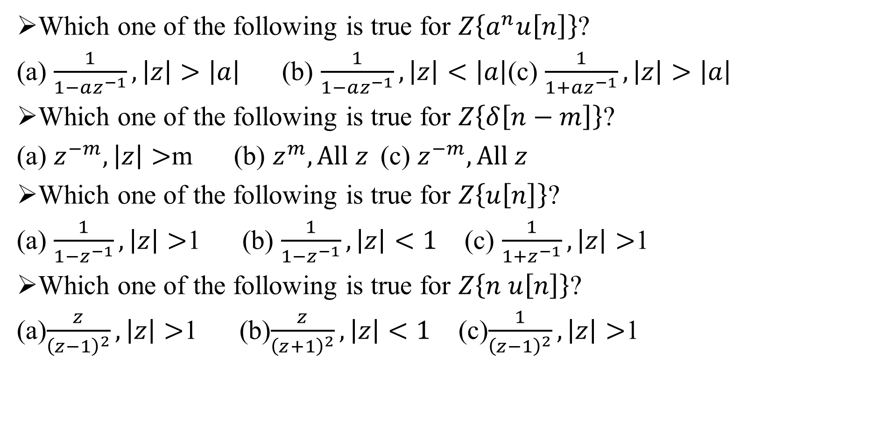
Sample MCQ:
Which one of the following is true for $Z\left\{a^{n}u\left[n\right]\right\}$?
(a) $\frac{1}{1−az^{−1}}, \left|z\right|>\left|a\right|$ (b) $\frac{1}{1−az^{−1}}, \left|z\right|<\left|a\right|$(c) $\frac{1}{1+az^{−1}}, \left|z\right|>\left|a\right|$
Which one of the following is true for $Z\left\{δ\left[n−m\right]\right\}$?
(a) $z^{−m}, \left|z\right|>$m (b) $z^{m}, All z$(c) $z^{−m}, All z$
Which one of the following is true for $Z\left\{u\left[n\right]\right\}$?
(a) $\frac{1}{1−z^{−1}}, \left|z\right|>$1 (b) $\frac{1}{1−z^{−1}}, \left|z\right|<1$ (c) $\frac{1}{1+z^{−1}}, \left|z\right|>$1
Which one of the following is true for $Z\left\{n u\left[n\right]\right\}$?
(a)$\frac{z}{{\left(z−1\right)}^{2}}, \left|z\right|>$1 (b)$\frac{z}{{\left(z+1\right)}^{2}}, \left|z\right|<1$ (c)$\frac{1}{{\left(z−1\right)}^{2}}, \left|z\right|>$1

